Slide 1
CCPS 610 - Database Systems II
Assignment 2 Presentation
Karel Tutsu, Andrew Parsons, Roberto Mariani

Slide 2
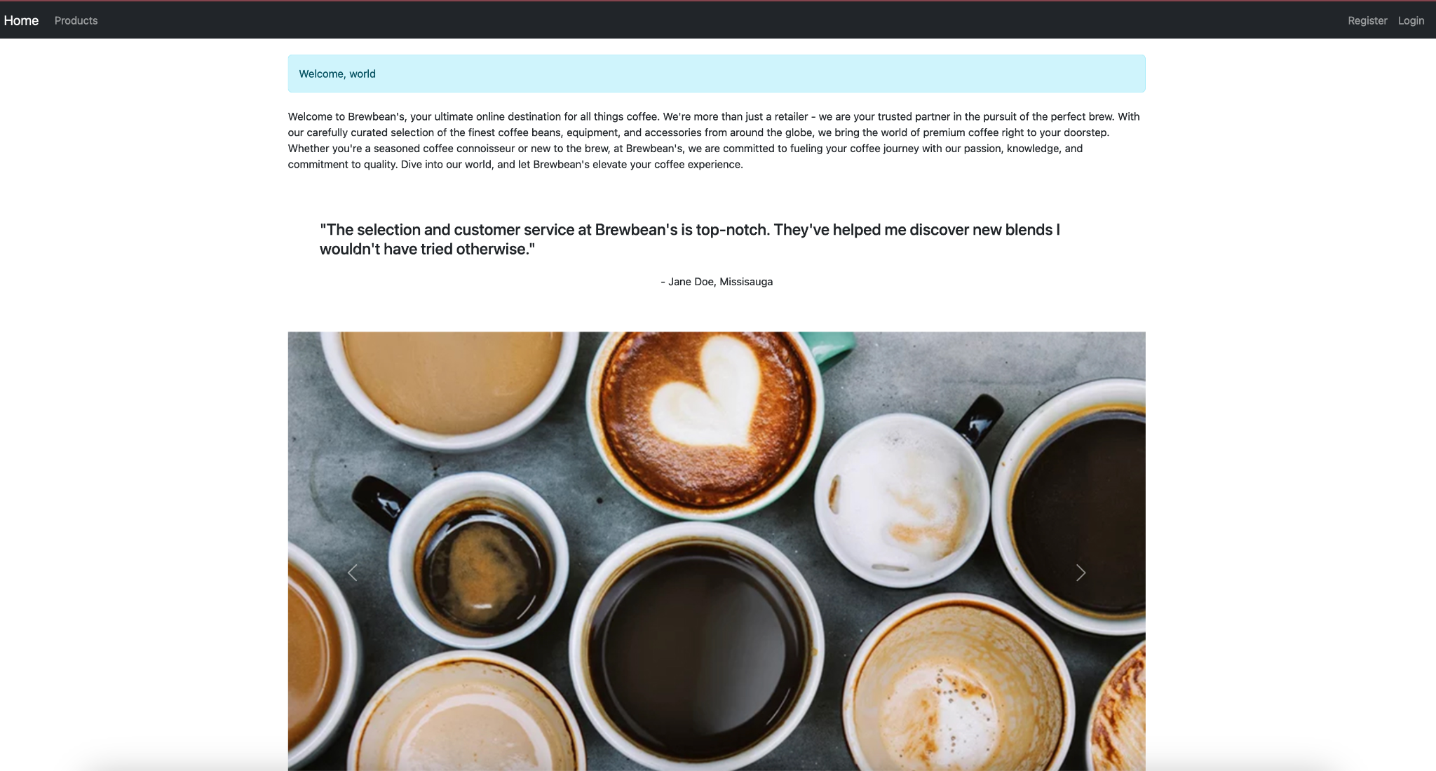
Welcome to Brewbean’s Coffee!

Slide 3
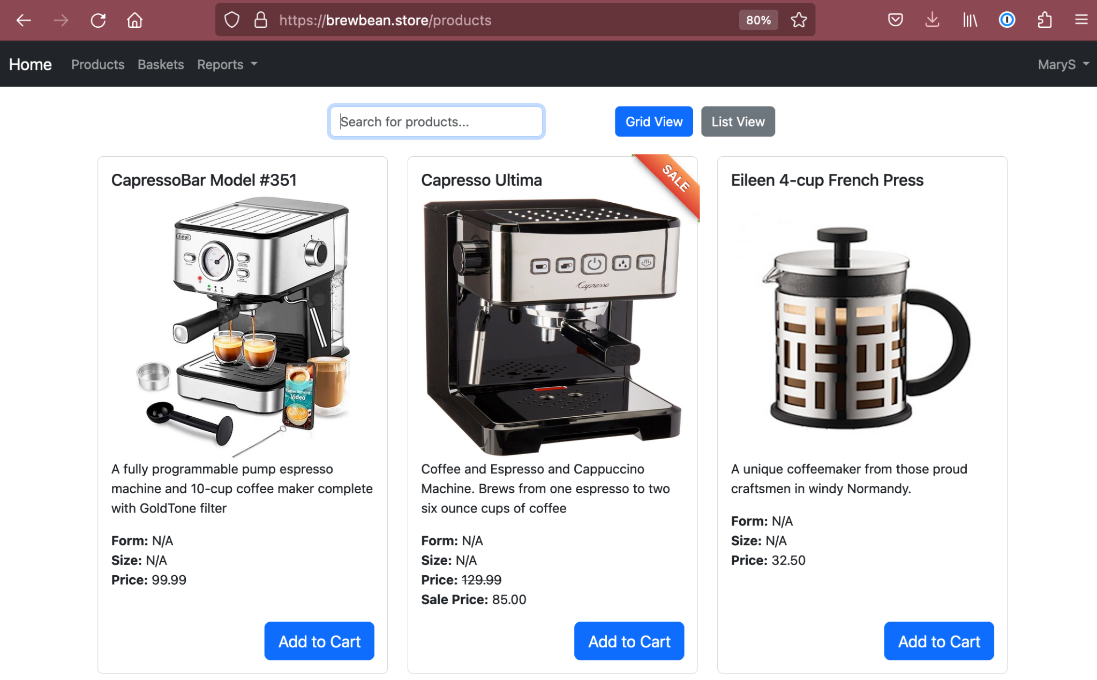
Brewbean - Site Navigation
Brewbean’s Coffee is an online retailer that sells coffee-making equipment and coffee beans
Shoppers can search or browse products, add products to their cart, create an account, and view those cart items in their basket
Additionally, users with Employee or Admin access can add products, edit product descriptions and view reports about each shopper and their total spend on the site
We will demonstrate the navigation with a live demo after this presentation

Slide 4
Brewbean - System Configuration
Core Technologies
MySQL Server 8.0.33
Navicat for MySQL
For creating stored procedures and other data table structures
Python3 + Flask 2.3.2
We utilized Flask to extend the python language to allow us to build html templates
VIM and VSCODE for editing HTML and python files
See the github repo for the latest MySQL build script for the project
Converted the original Oracle SQL dataset to MySQL
Additional Server Detail
Domain name bought from gandi.net for $1 (annual)
DigitalOcean Ubuntu VM $3 (monthly)
LetsEncrypt SSL certificate $0

Slide 5
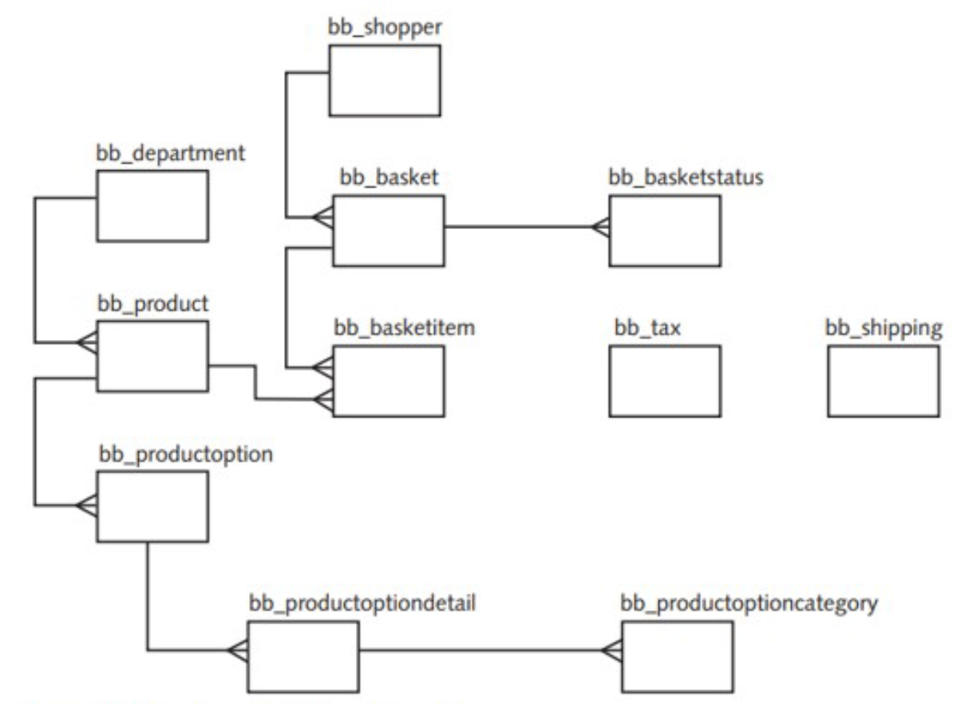
Brewbean - Backend
Initial ERD
Created Views
Created Procedures and Functions
bb_basket_admin
bb_basket_item_vu
bb_order_admin
bb_orderitems_admin
bb_product_admin
bb_product_employee
bb_product_guest
bb_ship_vu
all_items_in_stock
delete_basketitem_by_basketitemid
delete_product_by_productid
delete_user_by_email_and_username
get_account_by_accountid
get_basketitems_by_basketid_full
get_basketitems_by_basketid_shopper
get_baskets_by_admin
get_baskets_by_shopperid
get_basketstatus_by_basketid_full
get_basketstatus_by_basketid_shopper
get_checkout_by_shopperid
get_departments
get_product_by_productid
get_productoptions_by_productid
get_products_by_usergroup
get_purchase_amt_by_shopperid
get_sale_info
get_shopper_by_shopperid
get_tax_by_state_and_amount
get_taxrate_by_shopperid
get_total_purchase_amt
insert_audit_employee
insert_audit_logon
insert_basket
insert_basketitem
insert_checkout
insert_orderstatus
insert_product
is_account_by_accountid_and_username_and_password
is_basket_owner_by_basketid_and_shopperid
is_username_password
register_shopper
test_product_reset
test_shopper_reset
update_account_password
update_product
update_shopper
Created Triggers
set_proddepttype_before_insert
set_prodoptions_after

Slide 6
Brewbean - Frontend
START →
1. Create route for each frontend page
2. Call wrapper fn w/ appropriate auth
3. Request data or confirm from DB
app.py
sql.py
MySQL DB
5. Return data or confirm from wrapper function
4. Return data or confirm from DB
6. Create html template and pass along data
templates (*.html)
style.css
static files
(*.gif/jpg)
7. Source style from CSS and images from static files

Slide 7
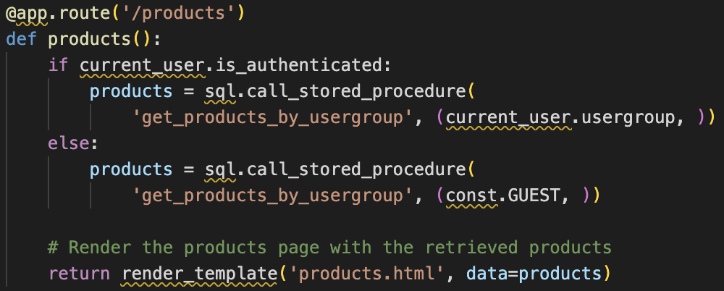
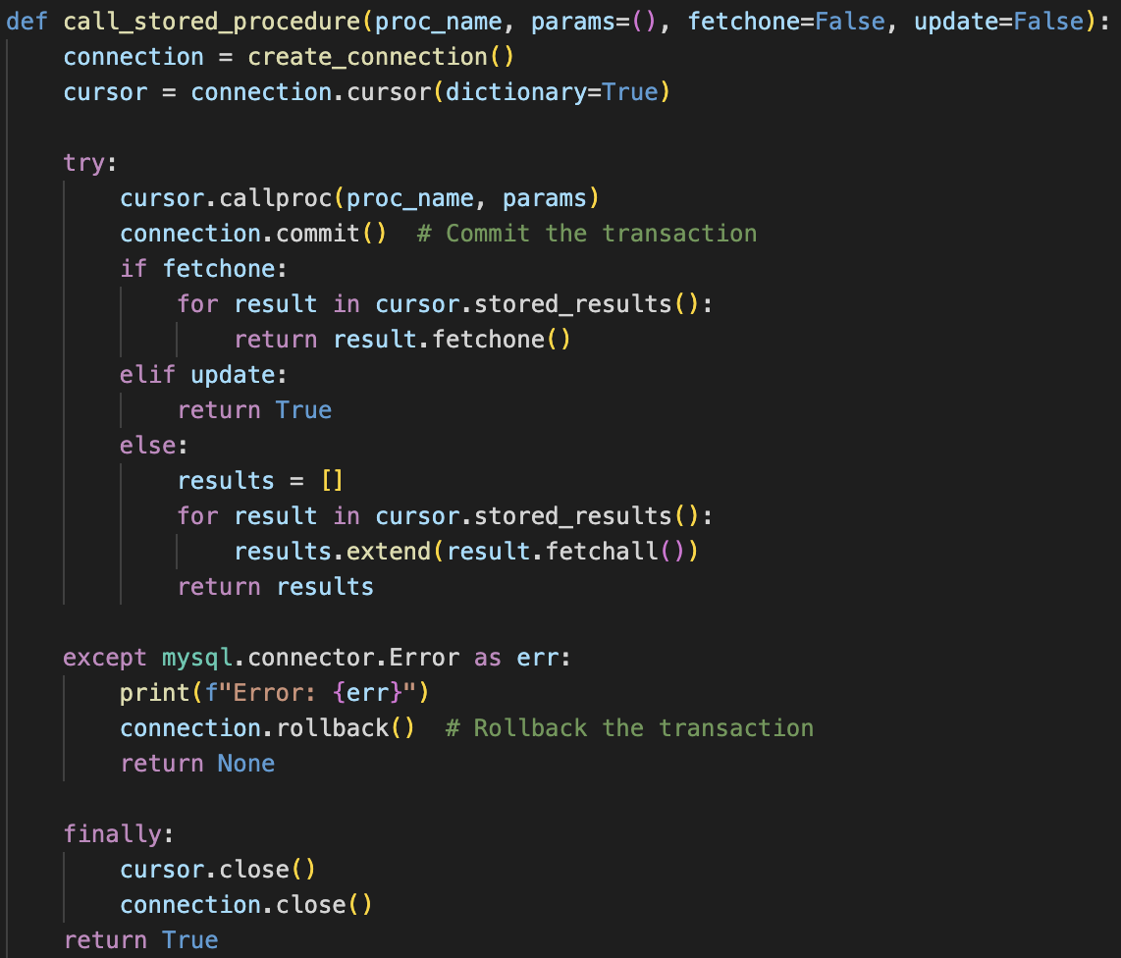
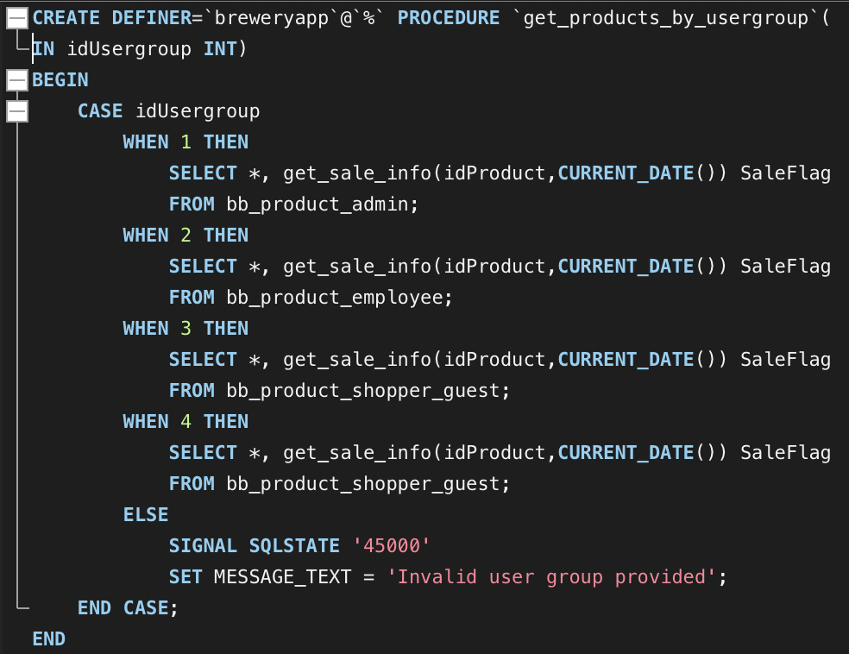
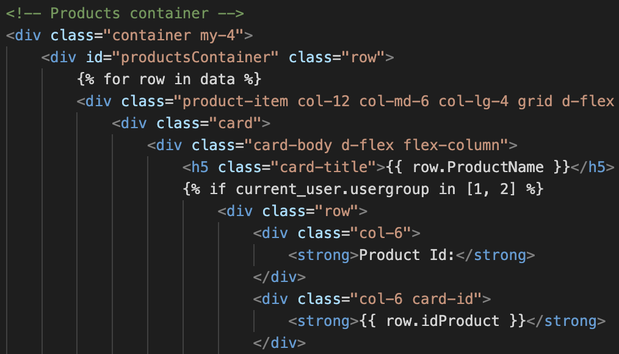
Brewbean - Example - Generating products.html
app.py
sql.py
MySQL DB
products.html

Slide 8
Brewbean - Requested Tasks / Reports
Tasks
Create functionality to alter a product’s description
Create functionality to add a product
Calculate tax on the order
Updating the order status
Add items to a basket
Identify and flag products on sale
Reports
Generate a report to show whether all items in a shopper’s basket are in stock or not
Generate a report that calculates each shopper’s total spend

Slide 9
Brewbean - Bonus Features
Session Control
System facilitates logging users in and out
New (Shopper) Account Registrations
Stored passwords are hashed in the database
Auditing logon and employee actions (requires admin access to view)
Usergroups
Guest (anonymous): View homepage and products
Shopper: + Place orders, View basket data, Edit profile, View Stock Report
Employee: + Edit products, Update Order Status, View all basket data, View Purchase Report
Admin: + View Logon and Employee Audits
Edit profile
Personal information (shoppers)
Update password (everyone)
Multiview products page (List view & Grid View)
Searching Basket Data (Employees and Admins)

Slide 10
Brewbean - Demo time!
brewbean.store

